Slide 1



Undergraduate Research Seminar Series
MM/DD/YY
Orchestrating Physics for Unconventional Computing [OPUS] Lab
[ Kerem Camsari]

Slide 2
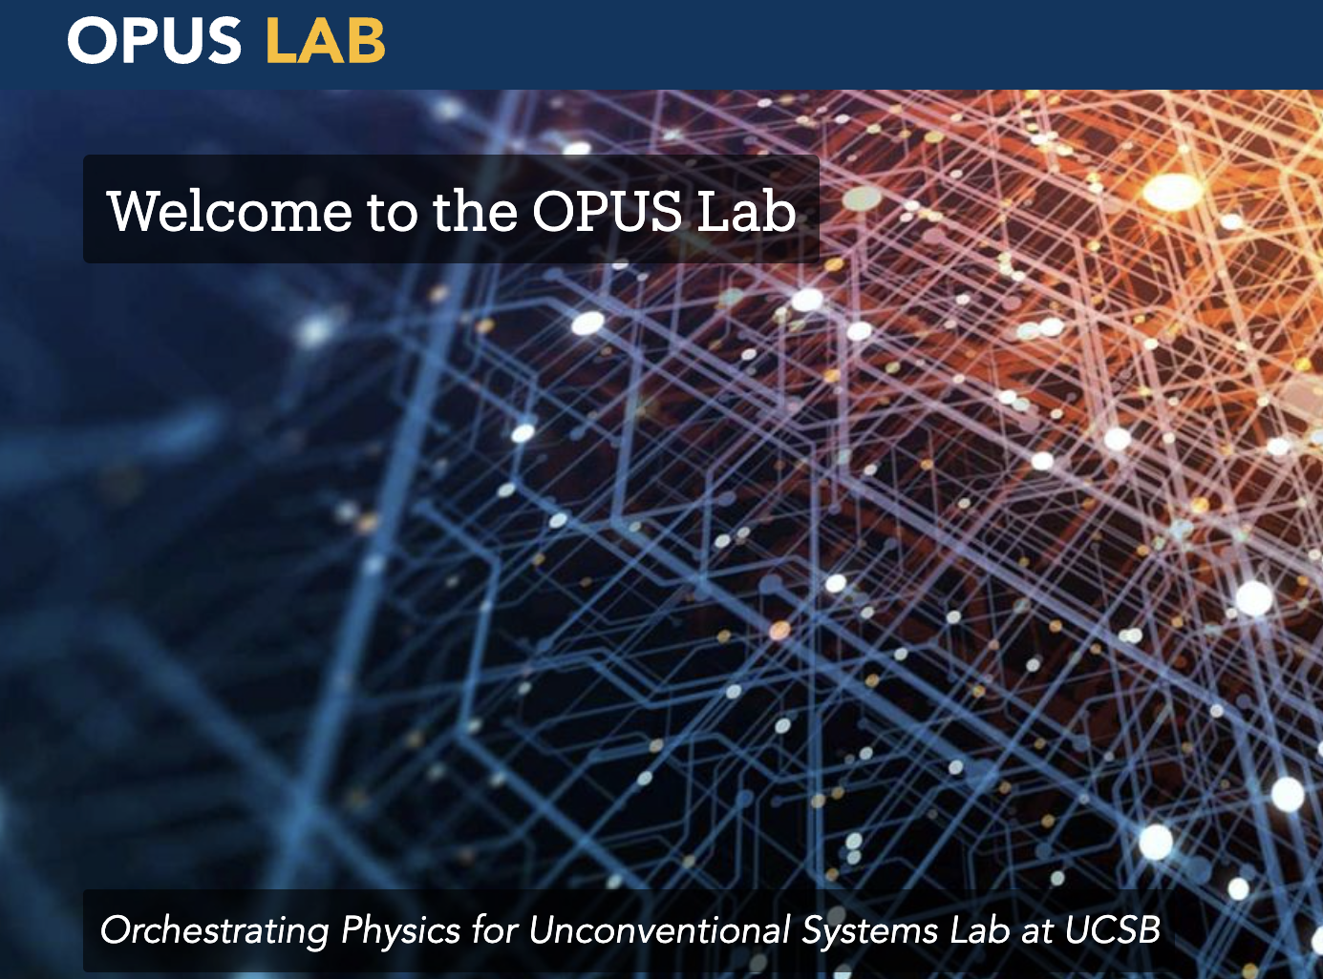
Lab Overview
Physics – Architecture – Algorithms for AI
Highly interdisciplinary lab
Ellison Hall, Harold Frank Hall
15 graduate researchers
2 Postdocs
12 PhDs
1 Master’s
2 Resident undergraduates
Multiple visiting international researchers year around

Slide 3
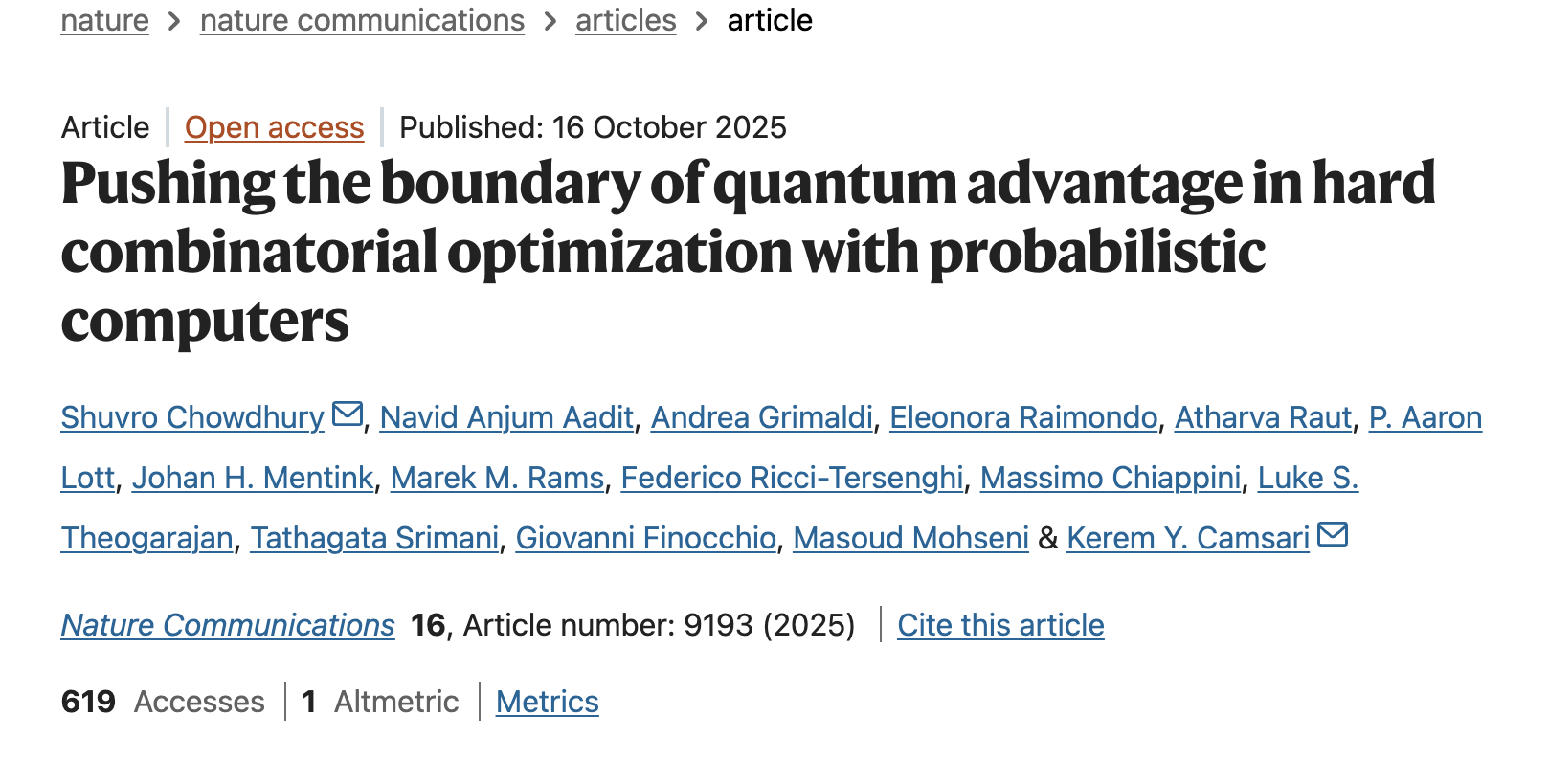
Recent Works: Quantum vs Probabilistic Comp.

Slide 4
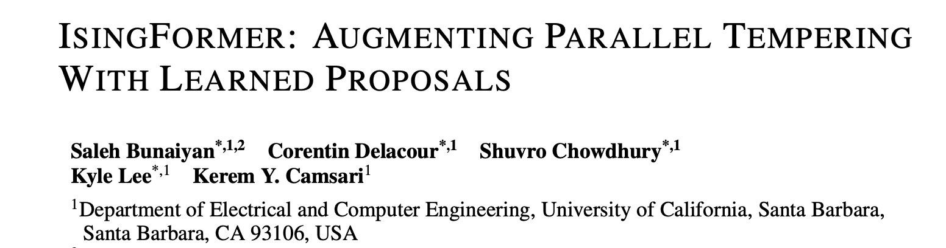
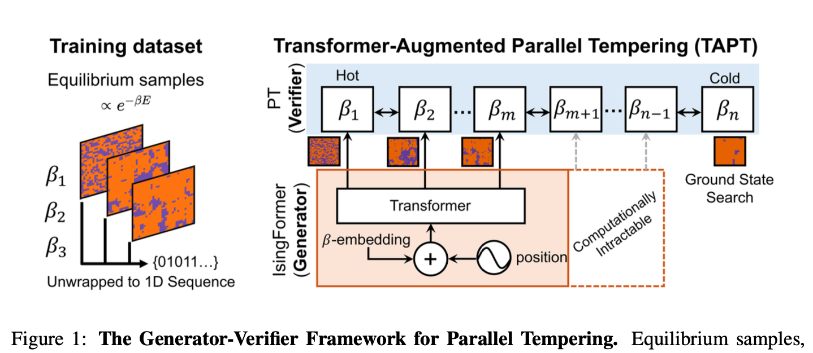
Recent Works: AI for probabilistic computing

Slide 5
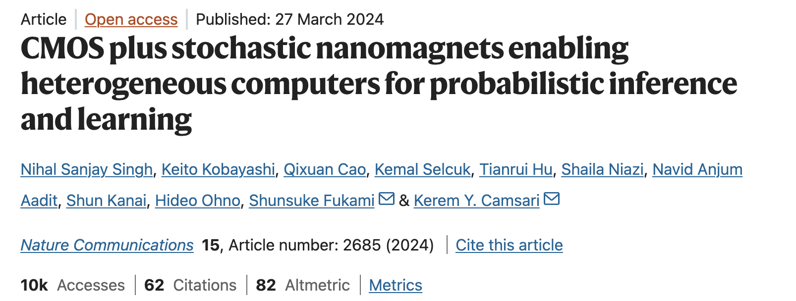
Recent Works: Nanodevices for energy-efficiency
Undergraduate Researchers

Slide 6
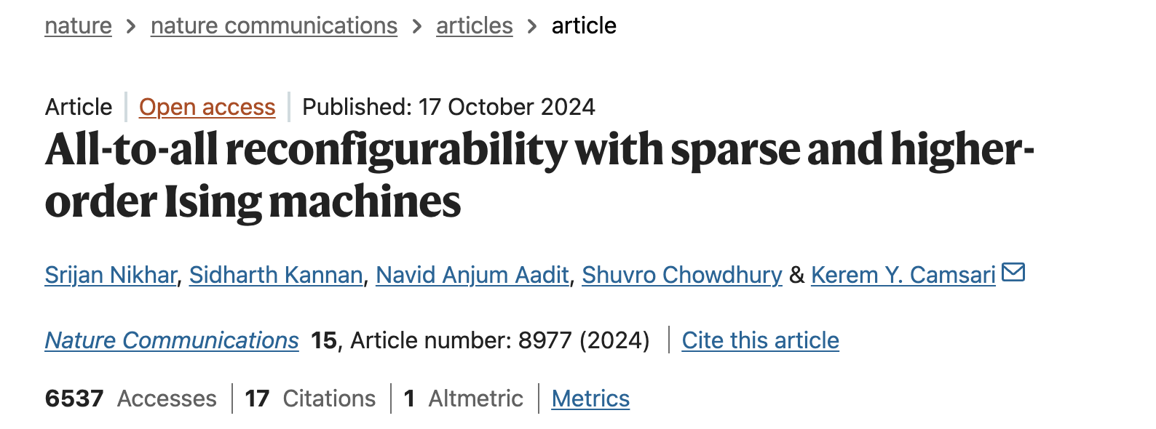
Recent Works: Combinatorial optimization with dedicated probabilistic computers
Undergraduate Researcher, equally contributing first author

Slide 7
Publications with undergraduates
Lab philosophy: treat undergraduate researchers as adults
Definition of success: making UGs published authors in original research This helps tremendously with graduate school prospects
By the numbers:
8 papers in top venues with undergraduates in the last 2 years
Pubs: Nature Communications (x3), International Electron Devices Meeting (x3), (Nature) Communications Physics (x1)
2 first author UGs → generally a much, much higher bar achieved only by ~1-5%
2 Semiconductor Research Corporation Undergraduate Fellows
Our UG alumni are well-placed: Stanford, UPenn, UT Austin, Columbia, UCSB, Carneige Mellon, UCLA, including NSF Fellows

Slide 8
Undergraduate Responsibilities Examples
Undergraduates are paired with graduate students as soon as they join OPUS
We believe in small steps and phase transitions (i.e., large qualitative changes after repeated application of small steps)
We do NOT go after UG researchers: about 60-70% early members silently drop, we understand, UG life is not easy.
Easy to join, hard to stick

Slide 9
Expectations
General Timeline: Undergraduates never work in a vacuum in OPUS – however, if they start consuming graduate student volunteer time without contributing meaningfully in return, we do not pursue them
Time Commitment: We generally avoid from giving exact time commitments:
No substitute for hard work
Research is a nonlinear exercise
Key is genuine commitment.

Slide 10
What Constitutes Success?
Concretely helping an ongoing research project:
One student analyzed the quality of random number generated by a stochastic nanodevice, critically useful.
One student helped with experiments with nanodevices in the lab.
One student implemented, analyzed a chaotic billiard ball system for optimization
One student implemented hypergraph coloring on their own
Learn the rules of the game: what constitutes new knowledge
How to create new knowledge – very different from classroom xp

Slide 11
Open Positions
We are always looking for bright, passionate and persistent undergraduates
Our biggest expectation is desire to learn and do something
Selection process is relatively disorganized. We give students an easy exercise: an immediate test on whether they really want it. Those who keep coming back end up being “residents” featured
On our website.

Slide 12
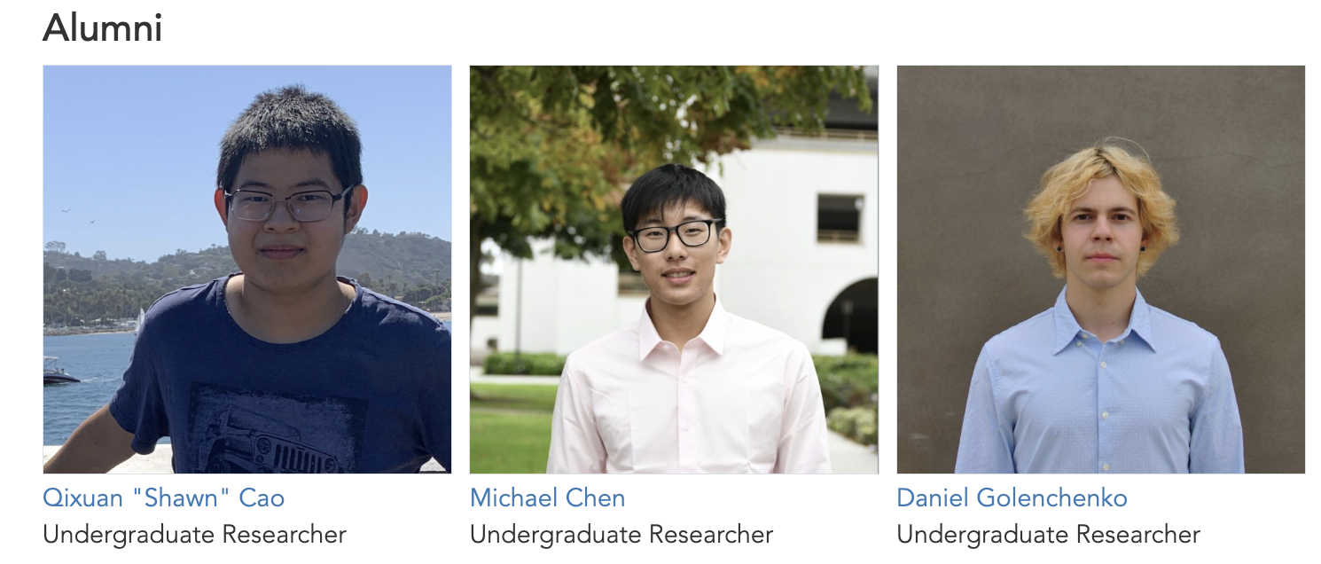
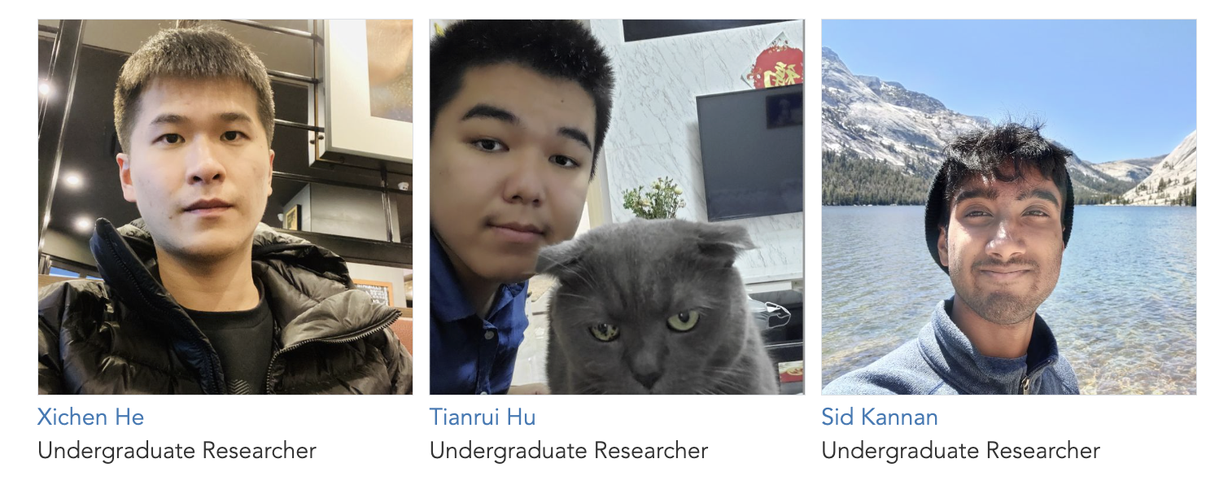
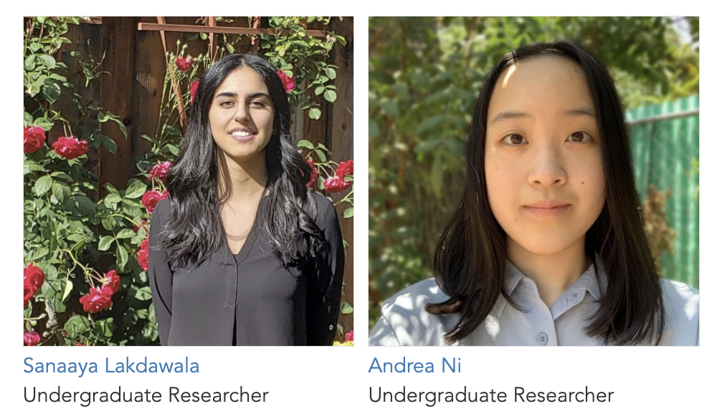
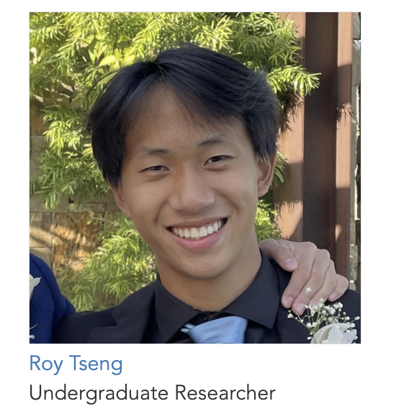
Resident Alumni
This is only our “resident” alumni – the true number of UGs we have interacted over the years is about an order of magnitude larger …

Slide 13
Q & A

